Slide 1
Lecture 19: Principal Component Analysis
Instructor: Yang Xu

Slide 2
Outline
What is & Why do we need PCA?
How to
Applications

Slide 3
What is principal component analysis (PCA)?
A dimensionality reduction technique that
Remove redundant (unwanted) dimensions
Keep the most important (informative) dimensions
High dimensional data:
Word embeddings (100-D, 300-D, etc.)
Image (16*16, 64*64, etc.)
Genes (Gene 1, Gene 2, …, Gene N)

Slide 4
Motivation Example A
Birds data
 | Bird 1 | Bird 2 | Bird 3 | Bird 4 | Bird 5 | Bird 6 | …
Weight | 10 | 11 | 8 | 3 | 2 | 1
Wingspan | 6 | 4 | 5 | 3 | 2.8 | 1
Length | 7 | 6.7 | 6 | 4.5 | 4 | 3.8
…
Questions:
How to visualize?
Which features are correlated?
Which features are most significant to describe the data?

Slide 5
Motivation Example A
Students data
 | S 1 | S 2 | S 3 | S 4 | S 5 | S 6 | …
Weight | 70 | 71 | 54 | 52 | 62 | 65
Height | 170 | 171 | 160 | 159 | 167 | 168
SAT | 1200 | 1080 | 1220 | 1160 | 1220 | 1210
IQ | 107 | 110 | 108 | 106 | 105 | 109
Questions:
How to visualize?
Which features are correlated?
Which features are most significant to describe the data?

Slide 6
The requirement of better data analysis
To find patterns → higher resolution of data → spread out across each dimension
Want dimensions to be independent → avoid redundancy

Slide 7
What does PCA do?
PCA finds a new set of dimensions such that all dimensions
Are orthogonal (guarantee independency)
Are ranked according to the variance of data along them (so that more important dimensions occur first)

Slide 8
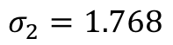
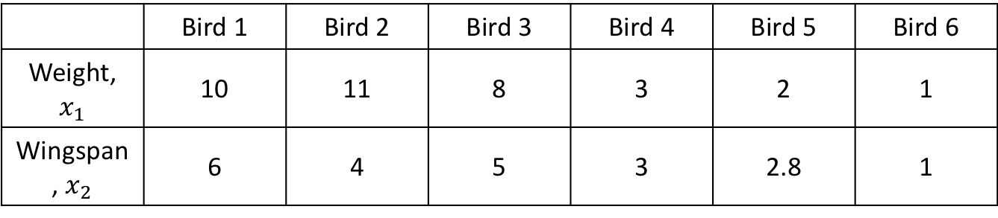
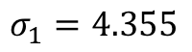
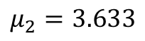
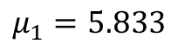
A simple example: reduce from 2-d to 1-d
 | Bird 1 | Bird 2 | Bird 3 | Bird 4 | Bird 5 | Bird 6
Weight, $x_{1}$ | 10 | 11 | 8 | 3 | 2 | 1
Wingspan, $x_{2}$ | 6 | 4 | 5 | 3 | 2.8 | 1
$$μ_{1}=5.833$$
$$σ_{1}=4.355$$
$$μ_{2}=3.633$$
$$σ_{2}=1.768$$
Wingspan
Weight

Slide 9
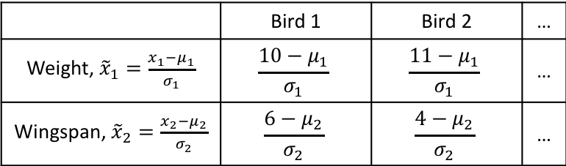
Normalize the data
 | Bird 1 | Bird 2 | …
Weight, ${\tilde{x}}_{1}=\frac{x_{1}−μ_{1}}{σ_{1}}$ | $$\frac{10−μ_{1}}{σ_{1}}$$ | $$\frac{11−μ_{1}}{σ_{1}}$$ | …
Wingspan, ${\tilde{x}}_{2}=\frac{x_{2}−μ_{2}}{σ_{2}}$ | $$\frac{6−μ_{2}}{σ_{2}}$$ | $$\frac{4−μ_{2}}{σ_{2}}$$ | …
Goal: Find a dimension that best describe the data
I.e., characterize as much variance as possible
Wingspan
I.e., let data points spread along that dimension as much as possible
Weight

Slide 10
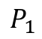
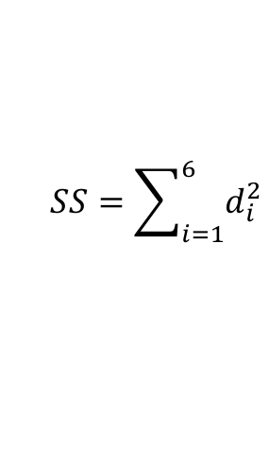
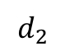
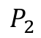
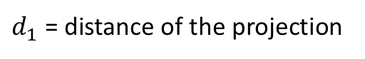
Find a good dimension to project
Candidate dimension
Total variance along this dimension?
Wingspan
Sum of square of the projections:
$$SS=\sum_{i=1}^{6}{d_{i}^{2}}$$
$$d_{2}$$
Want to maximize it
$$P_{2}$$
Weight
$d_{1}$ = distance of the projection
$$P_{1}$$

Slide 11
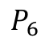
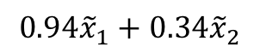
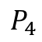
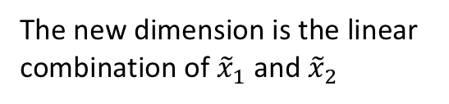
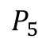
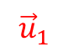
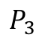
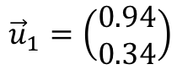
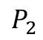
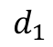
Maximize the sum of square of projections
Wingspan
The direction that maximizes SS
$$P_{6}$$
“Principal Component 1”, or “PC1”
$$P_{4}$$
$${\vec{u}}_{1}$$
$$P_{5}$$
Use a unit vector to denote PC1
$$P_{3}$$
$$P_{2}$$
Weight
$${\vec{u}}_{1}=\left(\begin{aligned}0.94 \\ 0.34\end{aligned}\right)$$
$$P_{1}$$
$$d_{1}$$
The new dimension is the linear combination of ${\tilde{x}}_{1}$ and ${\tilde{x}}_{2}$
$$0.94{\tilde{x}}_{1}+0.34{\tilde{x}}_{2}$$

Slide 12

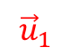
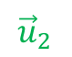
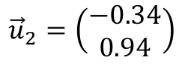

PC1 and PC2
The second principal component (PC2) is perpendicular to PC1
Wingspan
PC1
$$P_{6}$$
Use a unit vector to denote PC1
PC2
$$P_{4}$$
$${\vec{u}}_{2}=\left(\begin{aligned}−0.34 \\ 0.94\end{aligned}\right)$$
$${\vec{u}}_{2}$$
$$P_{3}$$
$${\vec{u}}_{1}$$
$$P_{5}$$
$$P_{2}$$
Weight
Note: ${\vec{u}}_{1}^{T}{\vec{u}}_{2}=0$
$$P_{1}$$
Projections on PC1 has larger variance than PC2:
$${SS}_{1}>{SS}_{2}$$

Slide 13
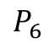
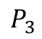
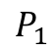
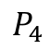
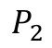
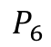
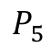
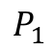
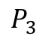
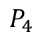
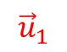
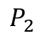
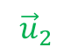
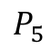
Rotate onto the new basis
Represent data using original features
Represent data using principal components
Wingspan
PC2
$$P_{6}$$
$$P_{6}$$
$$P_{4}$$
$$P_{4}$$
$${\vec{u}}_{2}$$
$$P_{3}$$
$$P_{5}$$
$$P_{3}$$
$${\vec{u}}_{1}$$
$$P_{5}$$
$$P_{2}$$
Weight
$$P_{2}$$
PC1
$$P_{1}$$
$$P_{1}$$
PC1 explains more variance than Weight

Slide 14
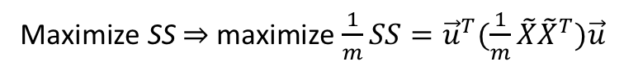
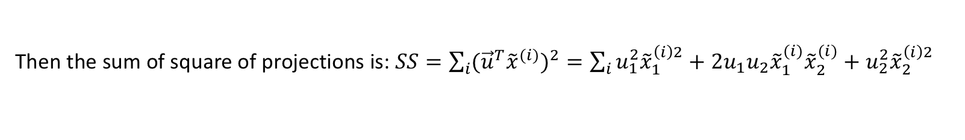
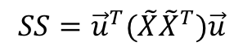
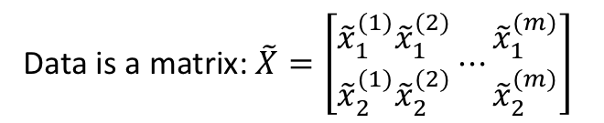
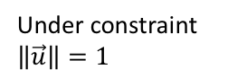
How to compute principal components?
Denote the principal component as a unit length vector $\vec{u}=\left(\begin{aligned}u_{1} \\ u_{2}\end{aligned}\right)$
The projection of data point ${\tilde{x}}^{(i)}=\left(\begin{aligned}{\tilde{x}}_{1}^{(i)} \\ {\tilde{x}}_{2}^{(i)}\end{aligned}\right)$ along $\vec{u}$ is the inner product: ${\vec{u}}^{T}{\tilde{x}}^{(i)}=u_{1}{\tilde{x}}_{1}^{(i)}+u_{2}{\tilde{x}}_{2}^{(i)}$
Then the sum of square of projections is: $SS=\sum_{i}{{({\vec{u}}^{T}{\tilde{x}}^{(i)})}^{2}}=\sum_{i}{u_{1}^{2}{\tilde{x}}_{1}^{\left(i\right)2}+2u_{1}u_{2}{\tilde{x}}_{1}^{(i)}{\tilde{x}}_{2}^{(i)}+u_{2}^{2}{\tilde{x}}_{2}^{\left(i\right)2}}$
Equivalent
Data is a matrix: $\tilde{X}=\left[\begin{aligned}{\tilde{x}}_{1}^{(1)} \\ {\tilde{x}}_{2}^{(1)}\end{aligned}\begin{aligned}{\tilde{x}}_{1}^{(2)} \\ {\tilde{x}}_{2}^{(2)}\end{aligned}⋯\begin{aligned}{\tilde{x}}_{1}^{(m)} \\ {\tilde{x}}_{2}^{(m)}\end{aligned}\right]$
$$SS={\vec{u}}^{T}(\tilde{X}{\tilde{X}}^{T})\vec{u}$$
Maximize SS ⇒ maximize $\frac{1}{m}SS={\vec{u}}^{T}(\frac{1}{m}\tilde{X}{\tilde{X}}^{T})\vec{u}$
Under constraint $\left\|\vec{u}\right\|=1$
Normalized data

Slide 15
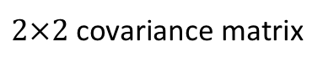

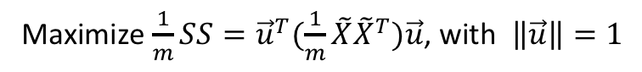

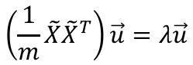
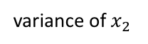
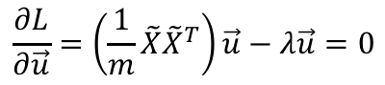
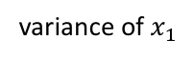
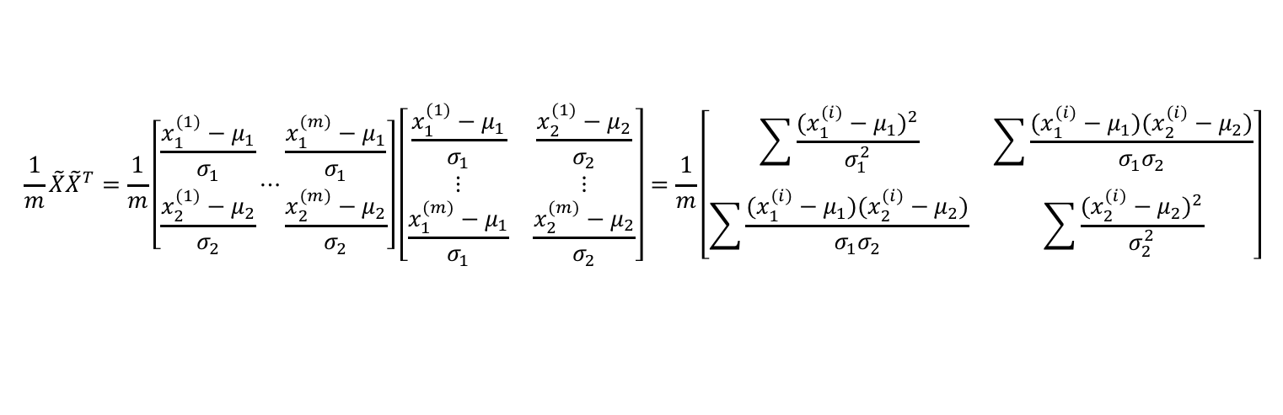


How to compute principal components (cont.)
Measures how much $x_{1}$ and $x_{2}$ are related (move in the same direction)
Maximize $\frac{1}{m}SS={\vec{u}}^{T}(\frac{1}{m}\tilde{X}{\tilde{X}}^{T})\vec{u}$, with $\left\|\vec{u}\right\|=1$
variance of $x_{1}$
covariance between $x_{1}$ and $x_{2}$
$$\frac{1}{m}\tilde{X}{\tilde{X}}^{T}=\frac{1}{m}\left[\begin{aligned}\frac{x_{1}^{(1)}−μ_{1}}{σ_{1}} \\ \frac{x_{2}^{(1)}−μ_{2}}{σ_{2}}\end{aligned}⋯\begin{matrix}\frac{x_{1}^{(m)}−μ_{1}}{σ_{1}} \\ \frac{x_{2}^{(m)}−μ_{2}}{σ_{2}}\end{matrix}\right]\left[\begin{matrix}\frac{x_{1}^{(1)}−μ_{1}}{σ_{1}} & \frac{x_{2}^{(1)}−μ_{2}}{σ_{2}} \\ \begin{aligned}⋮ \\ \frac{x_{1}^{(m)}−μ_{1}}{σ_{1}}\end{aligned} & \begin{aligned}⋮ \\ \frac{x_{2}^{(m)}−μ_{2}}{σ_{2}}\end{aligned}\end{matrix}\right]=\frac{1}{m}\left[\begin{matrix}\sum{\frac{{(x_{1}^{(i)}−μ_{1})}^{2}}{σ_{1}^{2}}} & \sum{\frac{(x_{1}^{(i)}−μ_{1})(x_{2}^{(i)}−μ_{2})}{σ_{1}σ_{2}}} \\ \sum{\frac{(x_{1}^{(i)}−μ_{1})(x_{2}^{(i)}−μ_{2})}{σ_{1}σ_{2}}} & \sum{\frac{{(x_{2}^{(i)}−μ_{2})}^{2}}{σ_{2}^{2}}}\end{matrix}\right]$$
variance of $x_{2}$
To solve this maximization problem, use the Lagrange Multiplier method:
$2×2$ covariance matrix
Sometimes denoted as $Σ$
maximize (unconstrained): $L={\vec{u}}^{T}\left(\frac{1}{m}\tilde{X}{\tilde{X}}^{T}\right)\vec{u}−λ({\vec{u}}^{T}\vec{u}−1)$
$$\frac{∂L}{∂\vec{u}}=\left(\frac{1}{m}\tilde{X}{\tilde{X}}^{T}\right)\vec{u}−λ\vec{u}=0$$
$$\left(\frac{1}{m}\tilde{X}{\tilde{X}}^{T}\right)\vec{u}=λ\vec{u}$$
Solution $\vec{u}$ is the principal eigenvector of $\frac{1}{m}\tilde{X}{\tilde{X}}^{T}$
The maximized SS is the corresponding eigenvalue

Slide 16


Linear algebra reviews
Eigenvectors and eigenvalues
For square matrix $A$ and column vector $\vec{v}$, if
$$A\vec{v}=λ\vec{v}$$
Then $\vec{v}$ is the eigenvector (or characteristic vector) of $A$, and $λ$ is the eigenvalue (or characteristic value)
Meanings:
$A$ is a linear transformation. Almost all vectors change direction when they are transformed by $A$ (i.e., multiplied by $A$)
Certain exceptional vectors $\vec{v}$ are in the same direction of $A\vec{v}$. Those are eigenvectors.
Transform an eigenvector by $A$, the resulting vector $A\vec{v}$ is a number $λ$ times the original $\vec{v}$.

Slide 17








Linear algebra reviews (cont.)
Spectral theorem:
If the $n×n$ matrix $A$ is symmetric ($A^{T}=A$), then $A$ is orthogonally diagonalizable and has only real eigenvalues.
In other words, there exist real numbers $λ_{1},⋯,λ_{n}$ (eigenvalues) and orthogonal, non-zero real vectors ${\vec{v}}_{1},⋯,{\vec{v}}_{n}$ (eigenvectors) such that for each $i=1,2,⋯,n$:
$$A{\vec{v}}_{i}=λ_{i}{\vec{v}}_{i}$$
If $A$ is a $m×n$ matrix, then the $m×m$ matrix $AA^{T}$ and the $n×n$ matrix $A^{T}A$ are both symmetric.
The matrices $AA^{T}$ and $A^{T}A$ share the same nonzero eigenvalues.
Usage:
if m and n are very different, say, $A$ is $2×500$
Proof: let $\vec{v}$ be a nonzero eigenvector of $A^{T}A$ with eigenvalue $λ≠0$
$$\left(A^{T}A\right)\vec{v}=λ\vec{v}$$
Then the quick way to find the eigenvalues of the $500×500$ matrix $A^{T}A$ is to first find the 2 eigenvalues of the $2×2$ matrix $AA^{T}$.
Multiply both sides with $A$ on the left:
$$A\left(A^{T}A\right)\vec{v}=Aλ\vec{v}$$
$$(AA^{T})(A\vec{v})=λ(A\vec{v})$$
The other 498 eigenvalues of $A^{T}A$ are all zero!
eigenvector

Slide 18

















Eigenvalues and eigenvectors of covariance matrix
When $X$ is $2×m$
There are 2 eigenvectors and eigenvalues
$Σ=\frac{1}{m}\tilde{X}{\tilde{X}}^{T}=\left[\begin{matrix}Var(x_{1}) & Cov(x_{1},x_{2}) \\ Cov(x_{1},x_{2}) & Var(x_{2})\end{matrix}\right]$ is a symmetric $2×2$ matrix
$$Σu_{1}=λ_{1}u_{1}$$
$$Σu_{2}=λ_{2}u_{2}$$
Let $λ_{1}>λ_{2}$
Total variance in data $T=λ_{1}+λ_{2}$
PC1 $u_{1}$ accounts for $\frac{λ_{1}}{T}$ of the total variance
PC1 $u_{2}$ accounts for $\frac{λ_{2}}{T}$
What if $X$ is $n×m$ → high dimensional data with n features
There are n eigenvectors and eigenvalues
$Σ=\frac{1}{m}\tilde{X}{\tilde{X}}^{T}=\left[\begin{aligned}Var(x_{1}) \\ Cov(x_{1},x_{2}) \\ ⋮ \\ Cov(x_{1},x_{n})\end{aligned}\begin{matrix}Cov(x_{1},x_{2}) \\ \begin{aligned}Var(x_{2}) \\ ⋮ \\ Cov(x_{2},x_{n})\end{aligned}\end{matrix}\begin{matrix}⋯ \\ \begin{aligned}⋯ \\ ⋱ \\ ⋯\end{aligned}\end{matrix}\begin{matrix}Cov(x_{1},x_{n}) \\ \begin{aligned}Cov(x_{2},x_{n}) \\ ⋮ \\ Var(x_{n})\end{aligned}\end{matrix}\right]$ is a symmetric $n×n$ matrix
$$Σu_{1}=λ_{1}u_{1}$$
$$Σu_{2}=λ_{2}u_{2}$$
…
$$Σu_{n}=λ_{n}u_{n}$$
Let $λ_{1}>λ_{2}>⋯>λ_{n}$
Total variance in data $T=λ_{1}+λ_{2}+⋯+λ_{n}$
PC1 $u_{1}$ accounts for $\frac{λ_{1}}{T}$ of the total variance
PC1 $u_{2}$ accounts for $\frac{λ_{2}}{T}$
…
PCn $u_{n}$ accounts for $\frac{λ_{n}}{T}$

Slide 19

Finding eigenvalues and eigenvectors in Python
Use the linalg module of numpy

Slide 20













Reduce to k dimensions
$X$ is $n×m$
$Σ=\frac{1}{m}\tilde{X}{\tilde{X}}^{T}$ is $n×n$
n eigenvectors and eigenvalues: $λ_{i},u_{i}$
Select the top k eigenvectors $u_{1},u_{2},⋯,u_{k}$, with top k eigenvalues $λ_{1}>λ_{2}>⋯>λ_{k}$
$$y^{(i)}=U^{T}{\tilde{x}}^{(i)}=\left[\begin{aligned}u_{1}^{T}{\tilde{x}}^{(i)} \\ u_{2}^{T}{\tilde{x}}^{(i)} \\ ⋮ \\ u_{k}^{T}{\tilde{x}}^{(i)}\end{aligned}\right]=\left[\begin{aligned}y_{1}^{(i)} \\ y_{1}^{(i)} \\ ⋮ \\ y_{k}^{(i)}\end{aligned}\right]$$
$$U=\left[\begin{matrix}| \\ u_{1} \\ |\end{matrix}\begin{matrix}| \\ u_{2} \\ |\end{matrix}⋯\begin{matrix}| \\ u_{k} \\ |\end{matrix}\right]$$
Span to a k-dimensional subspace
Project data point ${\tilde{x}}^{(i)}$ into this subspace
$$n×1$$
$n×k$ matrix
$$k×1$$
Project m examples into new subspace
$$Y=U^{T}\tilde{X}=\left[\begin{matrix}u_{1}^{T} \\ u_{2}^{T} \\ \begin{aligned}⋮ \\ u_{k}^{T}\end{aligned}\end{matrix}\right]\left[{\tilde{x}}^{(1)},{\tilde{x}}^{(2)},⋯,{\tilde{x}}^{(m)}\right]$$
Reduce n-dimensional data to k-dimensional
$$k×m$$
$$n×m$$
$Y$ are the coordinates of data in the new subspace
$$k×n$$
For visualization, k = 2 or 3

Slide 21









Covariance matrix of the transformed data
$Y$ is the transformed data
$$=\left[\begin{matrix}λ_{1} \\ \\ \begin{aligned} \\ \end{aligned}\end{matrix}\begin{matrix} \\ λ_{2} \\ \begin{aligned} \\ \end{aligned}\end{matrix}\begin{matrix} \\ \\ \begin{aligned}⋱ \\ \end{aligned}\end{matrix}\begin{matrix} \\ \\ \begin{aligned} \\ λ_{k}\end{aligned}\end{matrix}\right]$$
A diagonal matrix with eigenvalues as diagonal elements
Its covariance matrix: $Σ=\frac{1}{m}YY^{T}$
$$=\frac{1}{m}U^{T}\tilde{X}{(U^{T}\tilde{X})}^{T}=\frac{1}{m}U^{T}\left(\tilde{X}{\tilde{X}}^{T}\right)U=U^{T}\left(\frac{1}{m}\tilde{X}{\tilde{X}}^{T}\right)U$$
Therefore, all covariances $Var(y_{i},y_{j})$ are zero!
All dimensions are independent
Covariance matrix and the shape of data
$$Cov=\left[\begin{matrix}95 & 1 \\ 1 & 5\end{matrix}\right]$$
$$Cov=\left[\begin{matrix}50 & 40 \\ 40 & 50\end{matrix}\right]$$

Slide 22






Another method of PCA
Using Singular value decomposition (SVD)
$$X=UΣV^{T}$$
$n×n$ unitary matrix
$$m×n$$
$m×n$ rectangle diagonal matrix (singular values)
$m×m$ unitary matrix
$$XX^{T}=UΣV^{T}{(UΣV^{T})}^{T}=UΣ^{2}U^{T}$$
Principal directions
Eigenvalues = square of singular values

Slide 23

Summary: procedures of performing PCA
Normalize data: $X→\tilde{X}$, $n×m$
Find the eigenvectors and eigenvalues of the covariance matrix $\frac{1}{m}\tilde{X}{\tilde{X}}^{T}$, $u_{1},u_{2},⋯,u_{n}$, $λ_{1}>λ_{2}>⋯>λ_{n}$
Observe whether a small number of the $λ_{i}$ are much bigger than all the others, e.g., first k elements.
If yes, a dimension reduction is proper: n-dim → k-dim
Interpret the principal components:
Which ones are the most important?

Slide 24











Applications of PCA
Better interpretation of features
Case 1: Sibley’s Bird Database of North American birds
$X$ is $3×100$
 | Bird 1 | Bird 2 | Bird 3 | …
Length, $x_{1}$ | 4 | 5 | 6 | …
Wingspan, $x_{2}$ | 10 | 11 | 8 | …
Weight, $x_{3}$ | 6 | 4 | 5 | …
$$Σ=\left[\begin{matrix}91.4 & 171.9 & 298.0 \\ & 373.9 & 545.2 \\ & & 1297.3\end{matrix}\right]$$
$$\frac{λ_{1}}{λ_{1}+λ_{2}+λ_{3}}=92.3\%$$
$$\frac{λ_{2}}{λ_{1}+λ_{2}+λ_{3}}=7.3\%$$
$$λ_{1}=1626.5$$
$$λ_{2}=129.0$$
$$λ_{3}=7.1$$
PC1 = 0.22 Length + 0.41 Wingspan + 0.88 Weight
$$u_{1}=\left[\begin{aligned}0.22 \\ 0.41 \\ 0.88\end{aligned}\right]$$
$$u_{2}=\left[\begin{aligned}0.25 \\ 0.85 \\ −0.46\end{aligned}\right]$$
$$u_{3}=\left[\begin{aligned}0.94 \\ −0.32 \\ −0.08\end{aligned}\right]$$
It characterizes the “size”
PC2 = 0.25 Length + 0.85 Wingspan – 0.46 Weight
It characterizes the “stoutness”

Slide 25
Applications of PCA
Data compression
Data visualization (k = 2 or 3)
Preprocess a dataset and reduce its dimension before feeding to a supervised learning model
Eigenface method for face recognition

Slide 26


Eigenface
A training set of m face images. Each image is $100×100$
Flatten each image to column vector and stack them → $X$ of shape $10000×m$ (normalized)
Compute the eigenvectors and eigenvalues of the covariance matrix $\frac{1}{m}XX^{T}$, of shape $10000×10000$
Each eigenvector is of shape $10000×1$
Reshape it back to $100×100$ → It can be seen as a face image: “eigenface”
These 10000 eigenfaces can be used to represent new faces
Project a new image vector to a selected subset of eigenfaces
The projections can be used to identify the new face
In practice, choosing 100 to 150 eigenfaces are sufficient
Example of the first eigenvector (PC1)
From Jauregui (2012)

Slide 27
Next lecture
Clustering

